Slide 1
CSE-4743 Computer Security Part-2 Symmetric ciphers
Presented by
Asmaul Hosna Sadika Assistant Lecturer Dept of CSE, IIUC

Slide 2
Contents
What is Cryptography
Symmetric Cipher Model
Substitution Techniques
Transposition Techniques
Steganography
Block Ciphers and
Data Encryption.

Slide 3

What is Cryptography

Slide 4
What is Cryptography?
Cryptography is a technique of securing information and communications through the use of codes so that only those persons for whom the information is intended can understand and process it.
The prefix “crypt” means “hidden” and the suffix “graphy” means “writing”.
Features Of Cryptography
Confidentiality: Information can only be accessed by the person for whom it is intended and no other person except him can access it.
Integrity: Information cannot be modified in storage or transition between sender and intended receiver without any addition to information being detected.
Non-repudiation: The creator/sender of information cannot deny his intention to send information at a later stage.
Authentication: The identities of the sender and receiver are confirmed. As well destination/origin of the information is confirmed.
Interoperability: Cryptography allows for secure communication between different systems and platforms.
Adaptability: Cryptography continuously evolves to stay ahead of security threats and technological advancements.

Slide 5
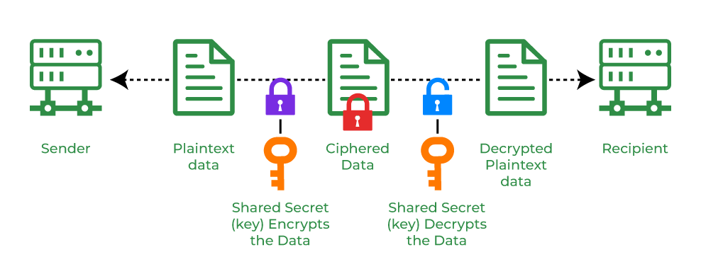
Types Of Cryptography
1. Symmetric Key Cryptography
It is an encryption system where the sender and receiver of a message use a single common key to encrypt and decrypt messages.
Symmetric Key cryptography is faster and simpler but the problem is that the sender and receiver have to somehow exchange keys securely.
The most popular symmetric key cryptography systems are
Data Encryption Systems (DES) and
Advanced Encryption Systems (AES).

Slide 6
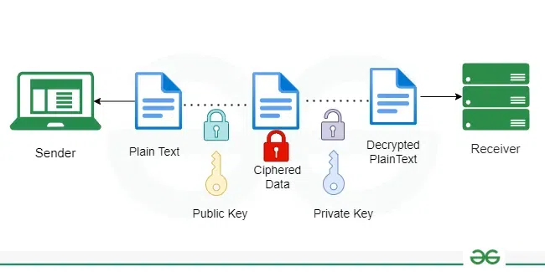
Types Of Cryptography
2. Asymmetric Key Cryptography
In Asymmetric Key Cryptography, a pair of keys is used to encrypt and decrypt information.
A receiver’s public key is used for encryption and a receiver’s private key is used for decryption. Public keys and Private keys are different. Even if the public key is known by everyone the intended receiver can only decode it because he alone knows his private key.
The most popular asymmetric key cryptography algorithm is the RSA algorithm.

Slide 7
Types Of Cryptography
3. Hash Functions
There is no usage of any key in this algorithm.
A hash value with a fixed length is calculated as per the plain text which makes it impossible for the contents of plain text to be recovered.
Many operating systems use hash functions to encrypt passwords.

Slide 8
Advantages of Cryptography
Access Control: Cryptography can be used for access control to ensure that only parties with the proper permissions have access to a resource. Only those with the correct decryption key can access the resource thanks to encryption.
Secure Communication: For secure online communication, cryptography is crucial. It offers secure mechanisms for transmitting private information like passwords, bank account numbers, and other sensitive data over the Internet.
Protection against attacks: Cryptography aids in the defense against various types of assaults, including replay and man-in-the-middle attacks. It offers strategies for spotting and stopping these assaults.
Compliance with legal requirements: Cryptography can assist firms in meeting a variety of legal requirements, including data protection and privacy legislation.

Slide 9
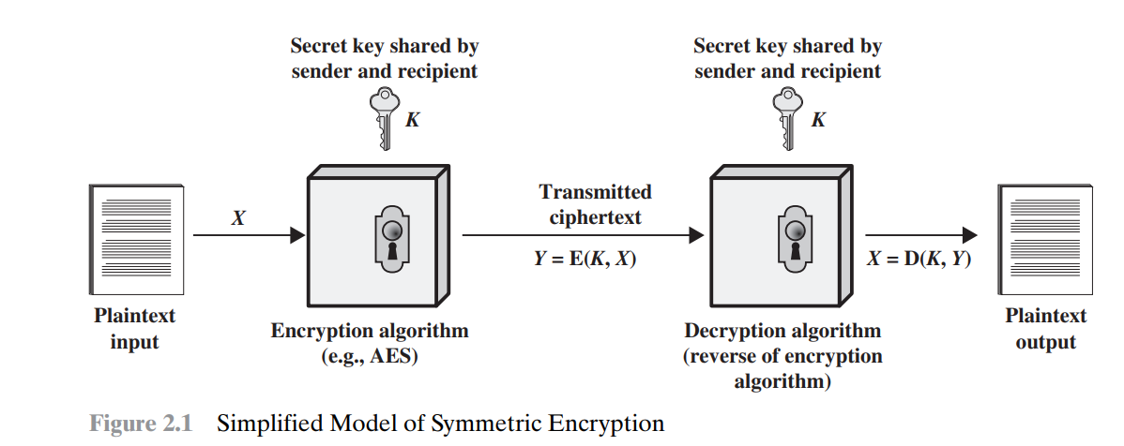
Model of symmetric encryption

Slide 10
Symmetric cipher model
A symmetric encryption scheme has five ingredients (Figure 2.1):
Plaintext: This is the original intelligible message or data that is fed into the algorithm as input.
Encryption algorithm: The encryption algorithm performs various substitutions and transformations on the plaintext.
Secret key: The secret key is also input to the encryption algorithm. The key is a value independent of the plaintext and of the algorithm. The algorithm will produce a different output depending on the specific key being used at the time. The exact substitutions and transformations performed by the algorithm depend on the key.
Ciphertext: This is the scrambled message produced as output. It depends on the plaintext and the secret key. For a given message, two different keys will produce two different ciphertexts. The ciphertext is an apparently random stream of data and, as it stands, is unintelligible.
Decryption algorithm: This is essentially the encryption algorithm run in reverse. It takes the ciphertext and the secret key and produces the original plaintext

Slide 11
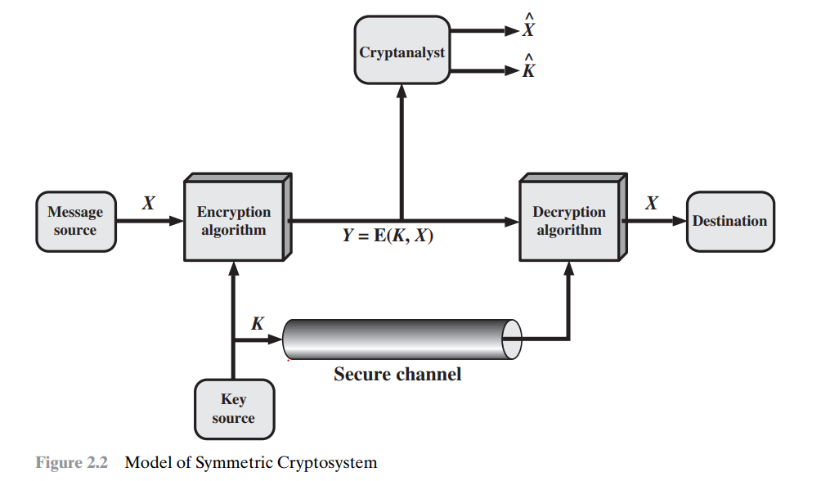
Model of Symmetric Cryptosystem

Slide 12
Symmetric Cryptosystem
Let us take a closer look at the essential elements of a symmetric encryption scheme, using Figure 2.2.
A source produces a message in plaintext, X = [X1, X2, c, XM]. The M elements of X are letters in some finite alphabet. Traditionally, the alphabet usually consisted of the 26 capital letters. Nowadays, the binary alphabet {0, 1} is typically used.
For encryption, a key of the form K = [K1, K2, c, KJ] is generated. If the key is generated at the message source, then it must also be provided to the destination by means of some secure channel. Alternatively, a third party could generate the key and securely deliver it to both source and destination.
With the message X and the encryption key K as input, the encryption algorithm forms the ciphertext Y = [Y1, Y2, …., YN]. We can write this as
Y = E(K, X)
The intended receiver, in possession of the key, is able to invert the transformation:
X = D(K, Y)

Slide 13
Symmetric Cryptosystem
How an attacker will try to attack this system?
An attacker, observing Y but not having access to K or X, may attempt to recover X or K or both X and K. It is assumed that the opponent knows the encryption (E) and decryption (D) algorithms.
If the opponent is interested in only this particular message, then the focus of the effort is to recover X by generating a plaintext estimate X^ .
Often, however, the opponent is interested in being able to read future messages as well, in which case an attempt is made to recover K by generating an estimate K^.
Cryptanalysis: Cryptanalytic attacks rely on the nature of the algorithm plus perhaps some knowledge of the general characteristics of the plaintext or even some sample plaintext–ciphertext pairs. This type of attack exploits the characteristics of the algorithm to attempt to deduce a specific plaintext or to deduce the key being used.
Brute-force attack: The attacker tries every possible key on a piece of ciphertext until an intelligible translation into plaintext is obtained. On average, half of all possible keys must be tried to achieve success.

Slide 14
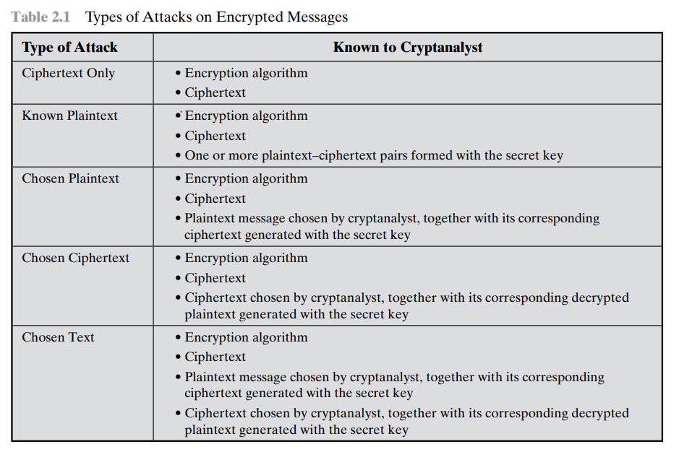
Attacks on ciphertext

Slide 15
Attacks on ciphertext
Table 2.1 summarizes the various types of cryptanalytic attacks based on the amount of information known to the cryptanalyst.
The most difficult problem is presented when all that is available is the ciphertext only. The ciphertext-only attack is the easiest to defend against because the opponent has the least amount of information to work with.
In many cases, however, the analyst has more information. The analyst may be able to capture one or more plaintext messages as well as their encryptions
Or the analyst may know that certain plaintext patterns will appear in a message.
If the opponent is working with the encryption of some general prose message, he or she may have little knowledge of what is in the message. However, if the opponent is after some very specific information, then parts of the message may be known.

Slide 16
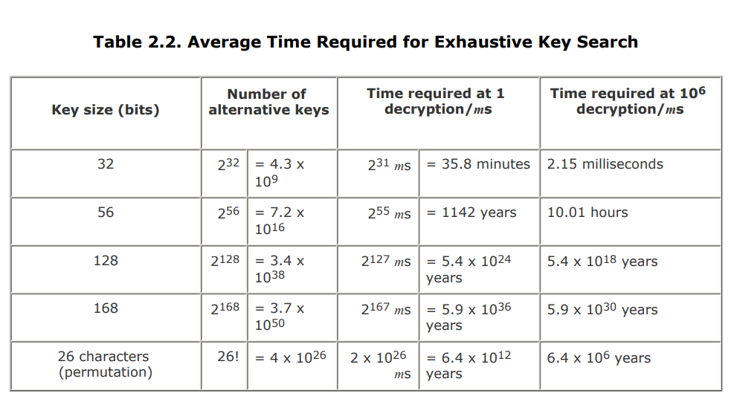
Brute force attack
A brute-force attack involves trying every possible key until an intelligible translation of the ciphertext into plaintext is obtained. On average, half of all possible keys must be tried to achieve success. Table 2.2 shows how much time is involved for various key spaces. Results are shown for four binary key sizes.

Slide 17
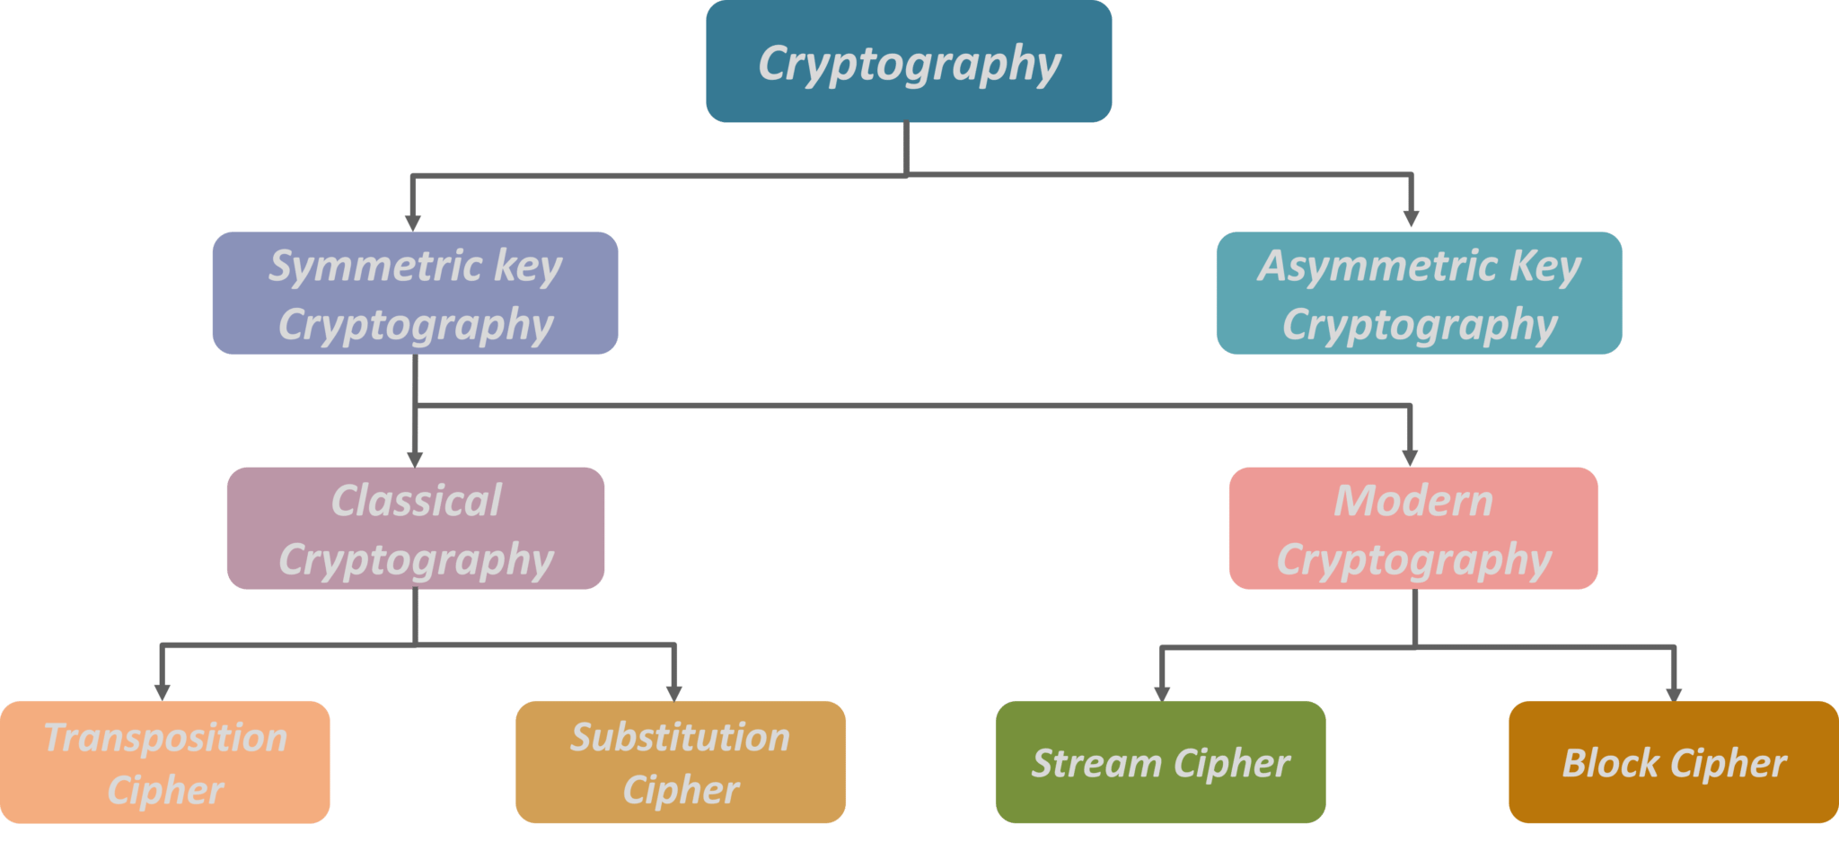
Types of cryptography

Slide 18
Encryption
The two basic building blocks of all encryption techniques are
Substitution encryption
Transposition encryption
Substitution technique
A substitution technique is one in which the letters of plaintext are replaced by other letters or by numbers or symbols.
If the plaintext is viewed as a sequence of bits, then substitution involves replacing plaintext bit patterns with ciphertext bit patterns
Transposition technique
Transposition Cipher is a cryptographic algorithm where the order of alphabets in the plaintext is rearranged to form a cipher text.
In this process, the actual plain text alphabets are included.

Slide 19
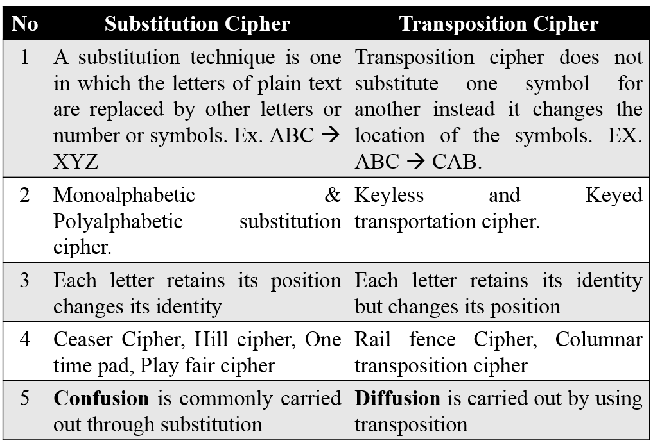
Substitution Vs Transposition

Slide 20
Caesar Cipher
The earliest known use of a substitution cipher, and the simplest, was by Julius Caesar. The Caesar cipher involves replacing each letter of the alphabet with the letter standing three places further down the alphabet.
For example,
plain: meet me after the toga party
cipher: PHHW PH DIWHU WKH WRJD SDUWB
Note that the alphabet is wrapped around, so that the letter following Z is A. We can define the transformation by listing all possibilities.

Slide 21
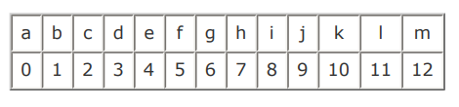

Caesar Cipher
Let us assign a numerical equivalent to each letter
Then the algorithm can be expressed as follows. For each plaintext letter p, substitute the ciphertext letter C:
C = E(3, p) = (p + 3) mod 26
A shift may be of any amount, so that the general Caesar algorithm is
C = E(k, p) = (p + k) mod 26
where k takes on a value in the range 1 to 25.
The decryption algorithm is simply p = D(k, C) = (C - k) mod 26

Slide 22
Vigenere Cipher
The best known, and one of the simplest, polyalphabetic ciphers is the Vigenere cipher.
In this scheme, the set of related monoalphabetic substitution rules consists of the 26 Caesar ciphers with shifts of 0 through 25.
Each cipher is denoted by a key letter, which is the ciphertext letter that substitutes for the plaintext letter a. Thus, a Caesar cipher with a shift of 3 is denoted by the key value 3
We can express the Vigenère cipher in the following manner.
Assume a sequence of plaintext letters P = p0, p1, p2, …, pn-1
and a key consisting of the sequence of letters K = k0, k1, k2, …., km-1,
where typically m < n.
The sequence of ciphertext letters C = C0, C1, C2,…., Cn-1 is calculated as follows
Ci = (pi + ki)mod 26
pi = (Ci - ki)mod 26

Slide 23
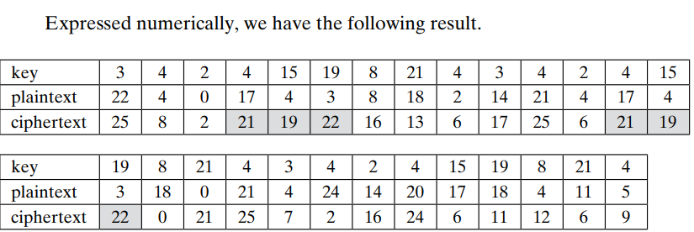
Vigenere Cipher
To encrypt a message, a key is needed that is as long as the message. Usually, the key is a repeating keyword. For example, if the keyword is deceptive, the message “we are discovered save yourself” is encrypted as
key: deceptivedeceptivedeceptive
plaintext: we are discovered save yourself
ciphertext: ZICVTWQNGRZGVTWAVZHCQYGLMGJ

Slide 24
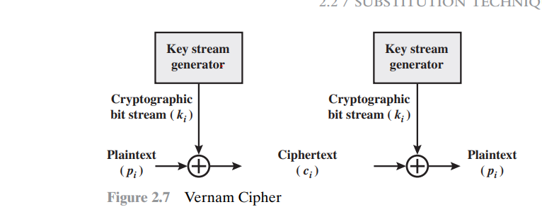
Vernam Cipher
Even vegenere scheme is vulnerable to cryptanalysis. Because the key and the plaintext share the same frequency distribution of letters, a statistical technique can be applied.
The ultimate defense against such a cryptanalysis is to choose a keyword that is as long as the plaintext and has no statistical relationship to it. Such a system was introduced by an AT&T engineer named Gilbert Vernam in 1918.
His system works on binary data rather than letters

Slide 25
Vernam Cipher
This system works on binary data (bits) rather than letters.
The system can be expressed succinctly as follows (Figure 2.7):
ci = pi ⊕ ki
where pi = ith binary digit of plaintext
ki = ith binary digit of key
ci = ith binary digit of ciphertext
⊕ = exclusive-or (XOR) operation
Thus, the ciphertext is generated by performing the bitwise XOR of the plaintext and the key. Because of the properties of the XOR, decryption simply involves the same bitwise operation:
pi = ci ⊕ ki

Slide 26
One-Time Pad
An Army Signal Corp officer, Joseph Mauborgne, proposed an improvement to the Vernam cipher that yields the ultimate in security.
Mauborgne suggested using a random key that is as long as the message, so that the key need not be repeated. In addition, the key is to be used to encrypt and decrypt a single message, and then is discarded.
Each new message requires a new key of the same length as the new message.
This scheme, known as a one-time pad, is unbreakable.
It produces random output that bears no statistical relationship to the plaintext. Because the ciphertext contains no information whatsoever about the plaintext, there is simply no way to break the code.

Slide 27
One-Time Pad
An example should illustrate our point.
Suppose that we are using a Vigenère scheme with 27 characters in which the twenty-seventh character is the space character, but with a one-time key that is as long as the message.
Consider the ciphertext ANKYODKYUREPFJBYOJDSPLREYIUNOFDOIUERFPLUYTS
We now show two different decryptions using two different keys:
ciphertext: ANKYODKYUREPFJBYOJDSPLREYIUNOFDOIUERFPLUYTS
key1: pxlmvmsydofuyrvzwc tnlebnecvgdupahfzzlmnyih
plaintext1: mr mustard with the candlestick in the hall
ciphertext: ANKYODKYUREPFJBYOJDSPLREYIUNOFDOIUERFPLUYTS
key2: pftgpmiydgaxgoufhklllmhsqdqogtewbqfgyovuhwt
plaintext2: miss scarlet with the knife in the library

Slide 28
One-Time Pad
Which is the correct key?
Suppose that a cryptanalyst had managed to find these two keys. Two plausible plaintexts are produced.
How is the cryptanalyst to decide which is the correct decryption?
If the actual key were produced in a truly random fashion, then the cryptanalyst cannot say that one of these two keys is more likely than the other. Thus, there is no way to decide which key is correct and therefore which plaintext is correct.
Disadvantage!

Slide 29
One-Time Pad
In theory, we need look no further for a cipher.
The one-time pad offers complete security but, in practice, has two fundamental difficulties:
There is the practical problem of making large quantities of random keys. Any heavily used system might require millions of random characters on a regular basis. Supplying truly random characters in this volume is a significant task.
Even more daunting is the problem of key distribution and protection. For every message to be sent, a key of equal length is needed by both sender and receiver. Thus, a mammoth key distribution problem exists. Because of these difficulties, the one-time pad is of limited utility and is useful primarily for low-bandwidth channels requiring very high security
BUT…..!
The one-time pad is the only cryptosystem that exhibits what is referred to as perfect secrecy.

Slide 30
Transposition Cipher
This encryption method is done by playing with the position of letters of the plain text.
The positions of the characters present in the plaintext are rearranged or shifted to form the ciphertext.
It makes use of some kind of permutation function to achieve the encryption purpose.
Transposition Cipher is a cryptographic algorithm where the order of alphabets in the plaintext is rearranged to form a cipher text. In this process, the actual plain text alphabets are not included.

Slide 31
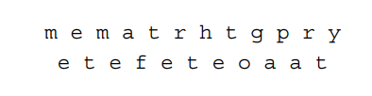
Rail fence cipher
The plaintext is written down as a sequence of diagonals and then read off as a sequence of rows.
For example, to encipher the message “meet me after the toga party” with a rail fence of key 2, we write the following:
The encrypted message is MEMATRHTGPRYETEFETEOAAT
This sort of thing would be trivial to cryptanalyze.

Slide 32
Single Columnar Transposition Cipher
In this technique, first, we write the message or plaintext in rows.
After that, we read the message column by column.
In this technique, we use a keyword to determine the no of rows. Plaintext: ATTACK POSTPONED UNTIL TWO AM
Key: 4 3 1 2 5 6 7
Plaintext: A T T A C K P
O S T P O N E
D U N T I L T
W O A M X Y Z
Ciphertext: TTNAAPTMTSUOAODWCOIXKNLYPETZ
A pure transposition cipher is easily recognized because it has the same letter frequencies as the original plaintext. For the type of columnar transposition just shown, cryptanalysis is fairly straightforward and involves laying out the ciphertext in a matrix and playing around with column positions. Digram and trigram frequency tables can be useful.

Slide 33
Double Columnar Transposition Cipher
Double Columnar Transposition Cipher is another form of Transposition Cipher Technique.
It is just similar to the columnar transposition technique.
The main objective of using a Double Columnar Transposition Cipher is to encrypt the message twice.
It makes use of the Single Columnar Transposition technique but uses two times.
It can use the same or different secret keys.
The output obtained from the first encryption will be the input to the second encryption.

Slide 34
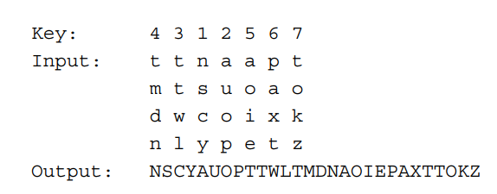
Double Columnar Transposition Cipher
The result is a more complex permutation that is not easily reconstructed.
To visualize the result of this double transposition, designate the letters in the original plaintext message by the numbers designating their position. Thus, with 28 letters in the message, the original sequence of letters is
01 02 03 04 05 06 07 08 09 10 11 12 13 14 15 16 17 18 19 20 21 22 23 24 25 26 27 28
After the first transposition, we have
03 10 17 24 04 11 18 25 02 09 16 23 01 08 15 22 05 12 19 26 06 13 20 27 07 14 21 28
which has a somewhat regular structure.
But after the second transposition, we have
17 09 05 27 24 16 12 07 10 02 22 20 03 25 15 13 04 23 19 14 11 01 26 21 18 08 06 28
This is a much less structured permutation and is much more difficult to cryptanalyze.

Slide 35
Rotor machine
From the previous lecture we have found out that multiple stages of encryption can produce an algorithm that is significantly more difficult to cryptanalyze. This is as true of substitution ciphers as it is of transposition ciphers.
The most important application of the principle of multiple stages of encryption was a class of systems known as rotor machines.
It implemented a very complex, varying substitution cipher
History: Machines based on the rotor principle were used by both Germany (Enigma) and Japan (Purple) in World War II.
The breaking of both codes by the Allies was a significant factor in the war’s outcome.

Slide 36
Rotor Machine
Structure
The machine consists of a set of independently rotating cylinders through which electrical pulses can flow.
Each cylinder has 26 input pins and 26 output pins, with internal wiring that connects each input pin to a unique output pin.
For simplicity, only three of the internal connections in each cylinder are shown.
If we associate each input and output pin with a letter of the alphabet, then a single cylinder defines a monoalphabetic substitution.
For example, in Figure 2.8, if an operator depresses the key for the letter A, an electric signal is applied to the first pin of the first cylinder and flows through the internal connection to the twenty-fifth output pin.

Slide 37
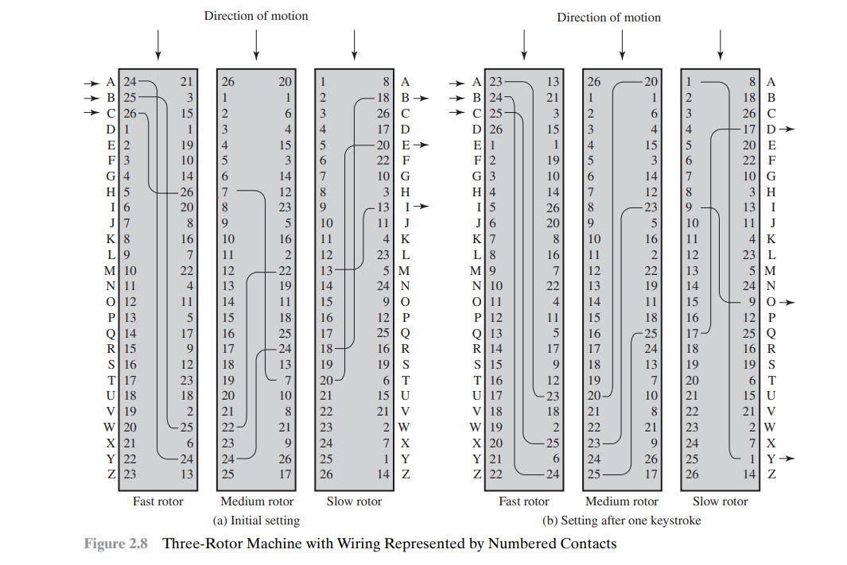
Basic principle of rotor machine

Slide 38
Basic principle of rotor machine
The power of the rotor machine is in the use of multiple cylinders, in which the output pins of one cylinder are connected to the input pins of the next. Figure 2.8 shows a three-cylinder system.
The left half of the figure shows a position in which the input from the operator to the first pin (plaintext letter a) is routed through the three cylinders to appear at the output of the second pin (ciphertext letter B).
With multiple cylinders, the one closest to the operator input rotates one pin position with each keystroke. The right half of Figure 2.8 shows the system's configuration after a single keystroke.
For every complete rotation of the inner cylinder, the middle cylinder rotates one pin position. Finally, for every complete rotation of the middle cylinder, the outer cylinder rotates one pin position.
This is the same type of operation seen with an odometer. The result is that there are 26 x 26 x 26 = 17,576 different substitution alphabets used before the system repeats.

Slide 39
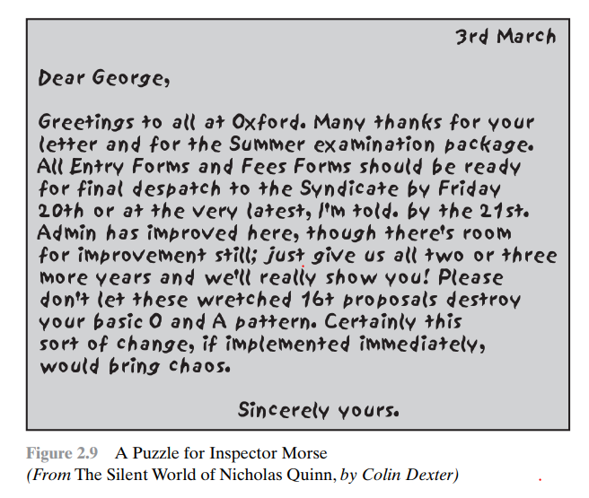
Steganography
A plaintext message may be hidden in one of two ways.
The methods of steganography conceal the existence of the message
whereas the methods of cryptography render the message unintelligible to outsiders by various transformations of the text. For example, the sequence of first letters of each word of the overall message spells out the hidden message.
A simple form of steganography, but one that is time-consuming to construct, is one in which an arrangement of words or letters within an apparently innocuous text spells out the real message
Decipher this . It’s not too hard!
Concealing the existence of the message
Change the message with various transformation

Slide 40
Steganography
Greetings to all at Oxford. Many thanks for your letter and for the Summer examination package. All Entry Forms and Fee Forms should be ready for final dispatch to the Syndicate by Friday 20th or at the very latest, I'm told, by the 21st. Admin has improved here, though there's room for improvement still; just give us all two or three more years and we'll really show you! Please don't let these wretched 16+ proposals destroy your basic O and A pattern. Certainly this sort of change, if implemented immediately, would bring chaos. Sincerely Yours.
Greetings to all at Oxford. Many thanks for your letter and for the Summer examination package. All Entry Forms and Fee Forms should be ready for final dispatch to the Syndicate by Friday 20th or at the very latest, I'm told, by the 21st. Admin has improved here, though there's room for improvement still; just give us all two or three more years and we'll really show you! Please don't let these wretched 16+ proposals destroy your basic O and A pattern. Certainly this sort of change, if implemented immediately, would bring chaos. Sincerely Yours.

Slide 41
Steganography
'Steganography' is not specifically a technique, but a general practice of concealing a message within other message. The hidden message appears not gibberish (as it does in cryptography), but appears to be something else.
Various other techniques have been used historically; some examples are the following :
Character marking: Selected letters of printed or typewritten text are over written in pencil. The marks are ordinarily not visible unless the paper is held at an angle to bright light.
Invisible ink: A number of substances can be used for writing but leave no visible trace until heat or some chemical is applied to the paper.
Pin punctures: Small pin punctures on selected letters are ordinarily not visible unless the paper is held up in front of a light.
Typewriter correction ribbon: Used between lines typed with a black ribbon, the results of typing with the correction tape are visible only under a strong light.

Slide 42
Steganography
In modern world, digital steganography techniques is used to
Hiding files, messages, images, documents or videos into another files, messages, images, documents or videos.
Most of such techniques work by hiding the 'bits' of original message/file into the 'bits'-representation of the 'cover'-message/file.
Some examples can be
Concealing messages within the lowest bits of 'noisy' images or sound files
Pictures embedded in the video material
Making text as the same color as the background in a document/blog

Slide 43
Steganography
Disadvantage
Steganography has a number of drawbacks when compared to encryption.
It requires a lot of overhead to hide a relatively few bits of information, although using a scheme like that proposed in the preceding paragraph may make it more effective.
Also, once the system is discovered, it becomes virtually worthless. This problem, too, can be overcome if the insertion method depends on some sort of key.
Solution: Alternatively, a message can be first encrypted and then hidden using steganography
Advantages
The advantage of steganography is that
It can be employed by parties who have something to lose should the fact of their secret communication be discovered. Encryption flags traffic as important or secret or may identify the sender or receiver as someone with something to hide.

Slide 44
What is Block Cipher?
An encryption technique that applies an algorithm with parameters to encrypt blocks of text.
Each plaintext block has an equal length of ciphertext block.
Each output block is the same size as the input block, the block being transformed by the key.
Block size range from 64 -128 bits and process the plaintext in blocks of 64 or 128 bits.
Several bits of information is encrypted with each block. Longer messages are encoded by invoking the cipher repeatedly.

Slide 45
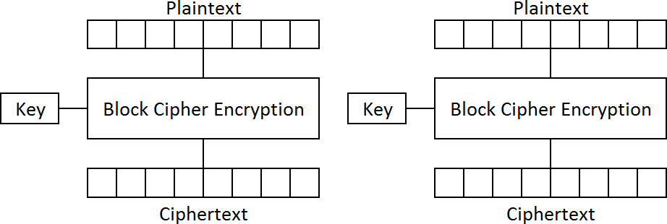
Block cipher
Each message (p) grouped in blocks is encrypted (enc) using a key (k) into a Ciphertext (c). Therefore, 𝑐 = 𝑒𝑛𝑐_{𝑘}(𝑝)
The recipient requires the same k to decrypt (dec) the p. Therefore,
𝑝 =𝑑𝑒𝑐_{𝑘}(𝑐)

Slide 46
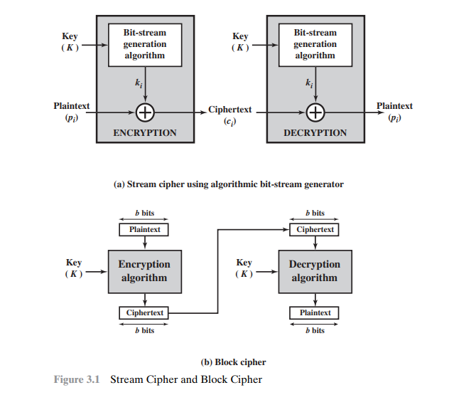
Stream cipher and Block cipher

Slide 47
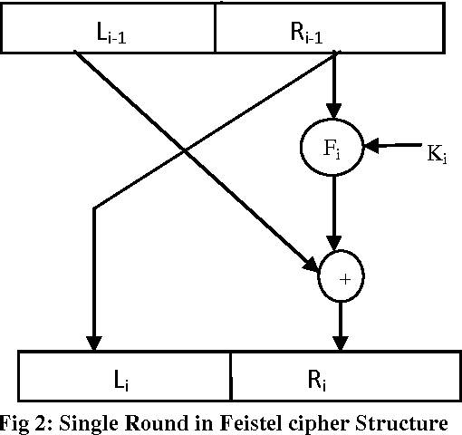
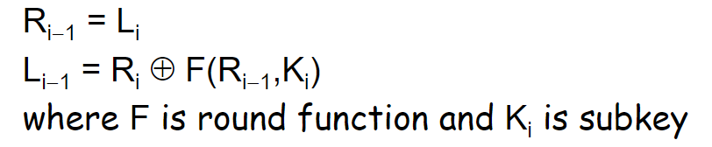
Feistel cipher
Feistel proposed the use of a cipher that alternates substitutions and permutations, where these terms are defined as follows:
Substitution: Each plaintext element or group of elements is uniquely replaced by a corresponding ciphertext element or group of elements.
Permutation: A sequence of plaintext elements is replaced by a permutation of that sequence. That is, no elements are added or deleted or replaced in the sequence, rather the order in which the elements appear in the sequence is changed

Slide 48
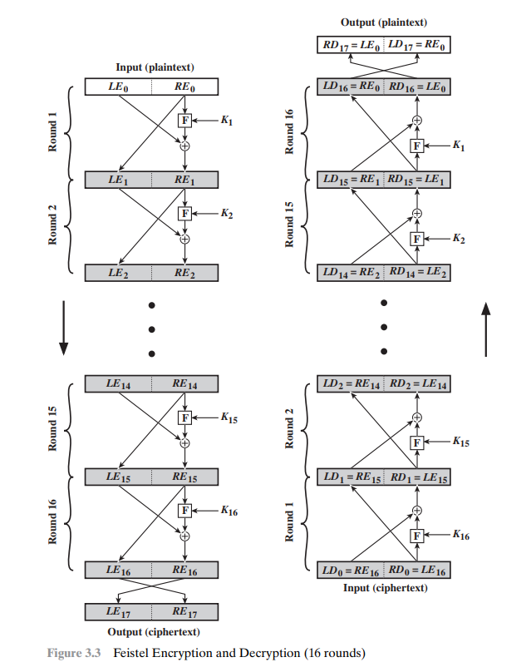

Slide 49
Feistel cipher Encryption
The input block to each round is divided into two halves that can be denoted as L and R for the left half and the right half.
In each round, the right half of the block, R, goes through unchanged. But the left half, L, goes through an operation that depends on R and the encryption key. First, we apply an encrypting function ‘f’ that takes two input − the key K and R. The function produces the output f(R,K). Then, we XOR the output of the mathematical function with L.
The permutation step at the end of each round swaps the modified L and unmodified R. Therefore, the L for the next round would be R of the current round. And R for the next round be the output L of the current round.
Above substitution and permutation steps form a ‘round’. The number of rounds are specified by the algorithm design.
Once the last round is completed then the two sub blocks, ‘R’ and ‘L’ are concatenated in this order to form the ciphertext block.

Slide 50
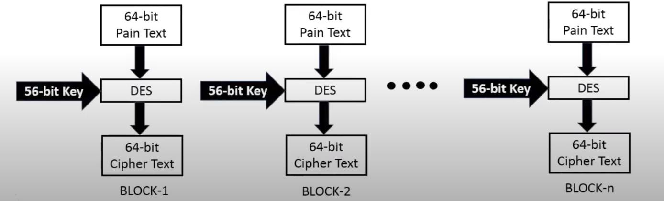
What is Data Encryption Standard (DES)?
The Data Encryption Standard (DES) is a symmetric-key block cipher.
It is now considered as a ‘broken’ block cipher, due primarily to its small key size.
DES is an implementation of a Feistel Cipher. It uses 16 round Feistel structure. The block size is 64-bit.
The General Structure of DES is depicted as follows,

Slide 51
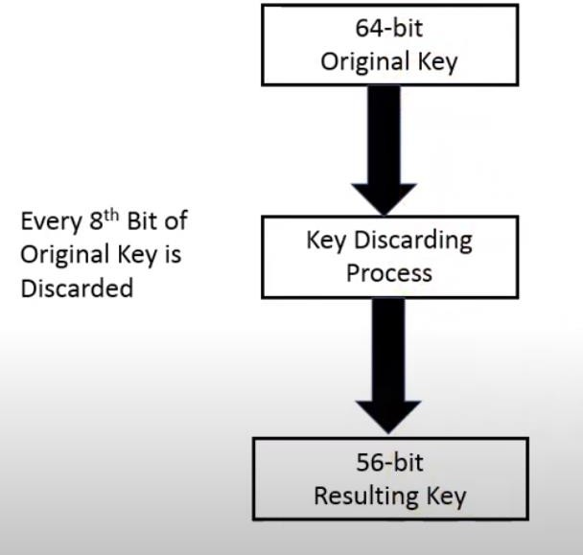
DES
We have mentioned that DES uses a 56-bit key. The initial key consists of 64 bits.
key is discarded to produce a 56-bit key.
The Key Discarding Process – conversion of a 64-bit key to a 56-bit key.
Before we enter the key to the DES process, the original key size is 64-bit and is converted to a 56-bit key.

Slide 52
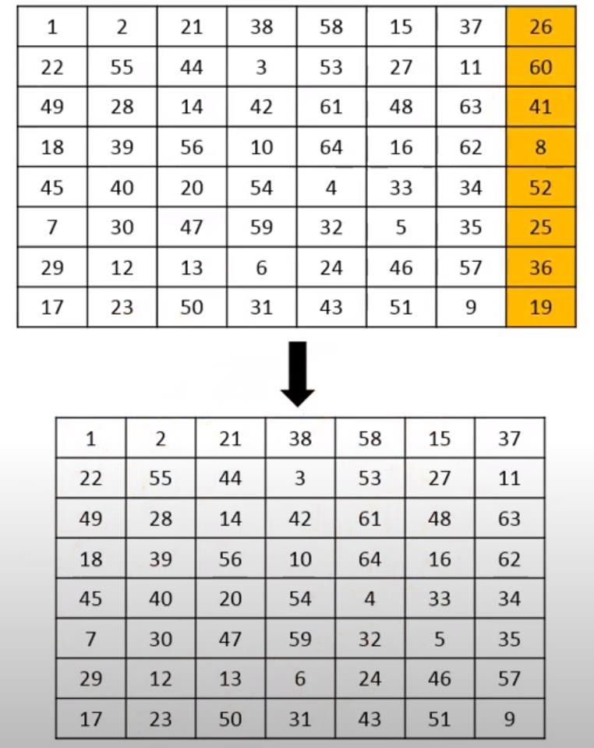
DES
The 64-bit original key is converted to a 56-bit resulting key.
Every 8-bit is discarded from the original key.
This results in generating a (7*8 = 56) 56-bit key.

Slide 53
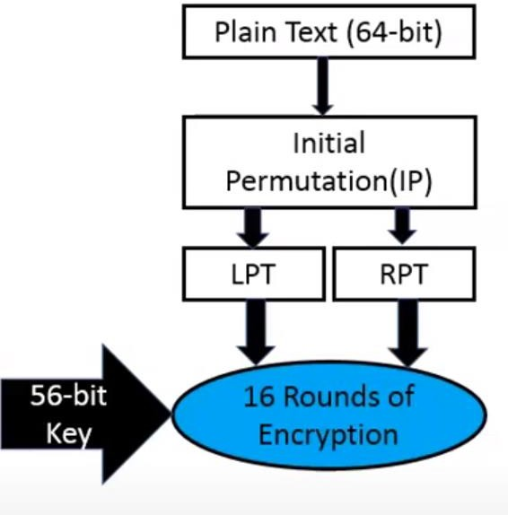
DES
64-bit plain text block is given to Initial Permutation (IP) function.
IP is performed on 64-bit plain text block.
After IP, the plaintext is converted into two same size blocks, Left plain text (LPT) and Right plain text (RPT).
After forming LPT and RPT, it serves as an input for 16 rounds of encryption.

Slide 54
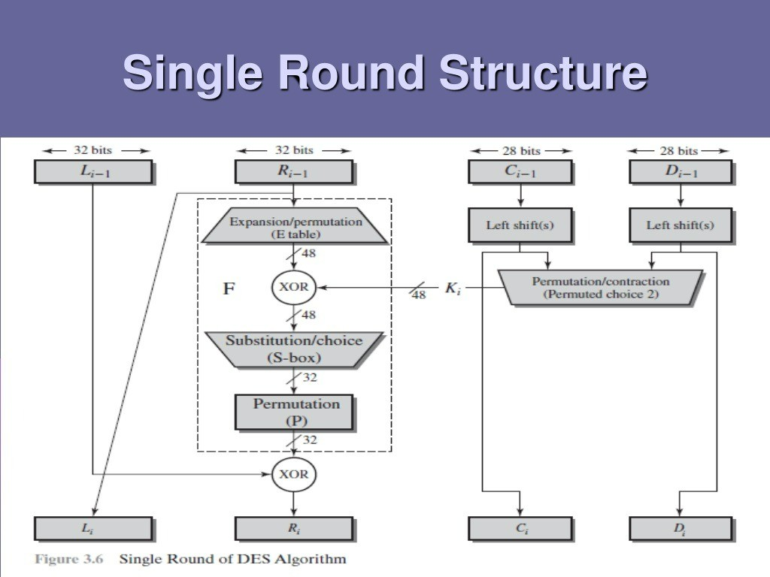

Slide 55
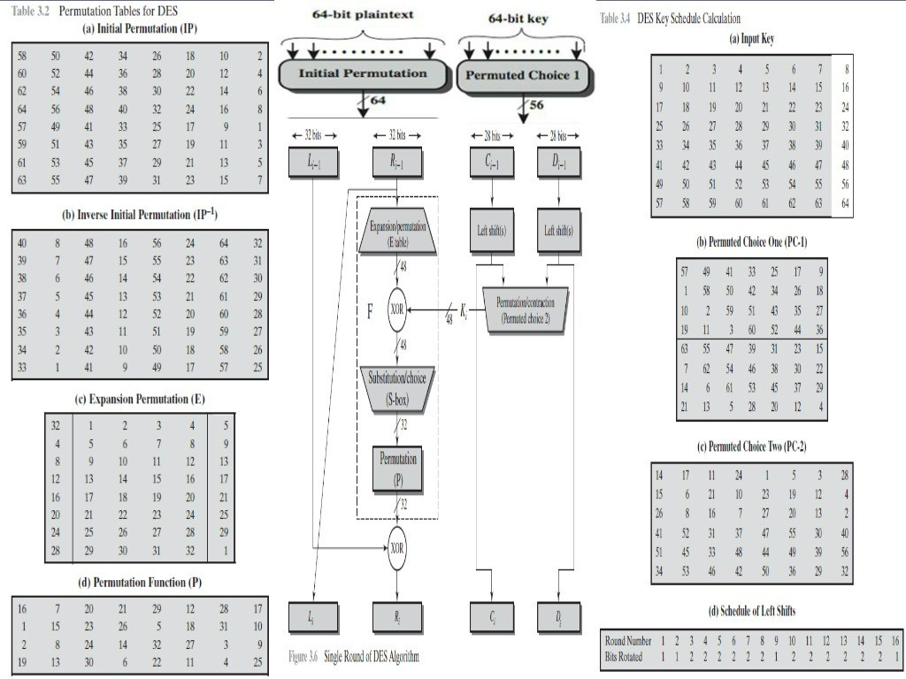

Slide 56
Step 1: Choose a 64-bit plaintext
Assume we have the following 64-bit plaintext (P):
P = 0110 1101 1001 0011 0101 1010 1110 0101 1100 1001 0111 0001 0010 1111 0000 1100
Breaking it down into 8 bytes (for clarity):
01101101 10010011 01011010 11100101 11001001 01110001 00101111 00001100
Step 2: Apply the Initial Permutation (IP)
We use the Initial Permutation (IP) table provided in the image. This table tells us how to reorder the bits.
For example, the first bit in IP is from position 58 in the original plaintext, the second bit in IP is from position 50, and so on.
Using the IP table:
Take bit 58 from P → Place it in position 1
Take bit 50 from P → Place it in position 2
Take bit 42 from P → Place it in position 3
Continue for all 64 bits...
After applying IP, we get a new permuted 64-bit sequence P' (output of initial permutation). Let’s assume after the IP transformation, we obtain:
P' = 11000011 10101000 01101110 10010111 11001001 01100001 10100100 01101001

Slide 57
Step 3: Apply the Inverse Initial Permutation (IP⁻¹)
Now, let’s reverse the permutation using the Inverse Initial Permutation (IP⁻¹) table. This table restores the original bit order.
Take bit 40 from P' → Place it in position 1
Take bit 8 from P' → Place it in position 2
Take bit 48 from P' → Place it in position 3
Continue for all 64 bits...
After applying IP⁻¹, we should get back our original plaintext (P):
01101101 10010011 01011010 11100101 11001001 01110001 00101111 00001100 Plaintext: 01101101 10010011 01011010 11100101 11001001 01110001 00101111 00001100
IP: 01000011 10101000 01101110 10010111 11001001 01100001 10100100 01101001
IP⁻¹ : 01101101 10010011 01011010 11100101 11001001 01110001 00101111 00001100
which is exactly what we started with!

Slide 58
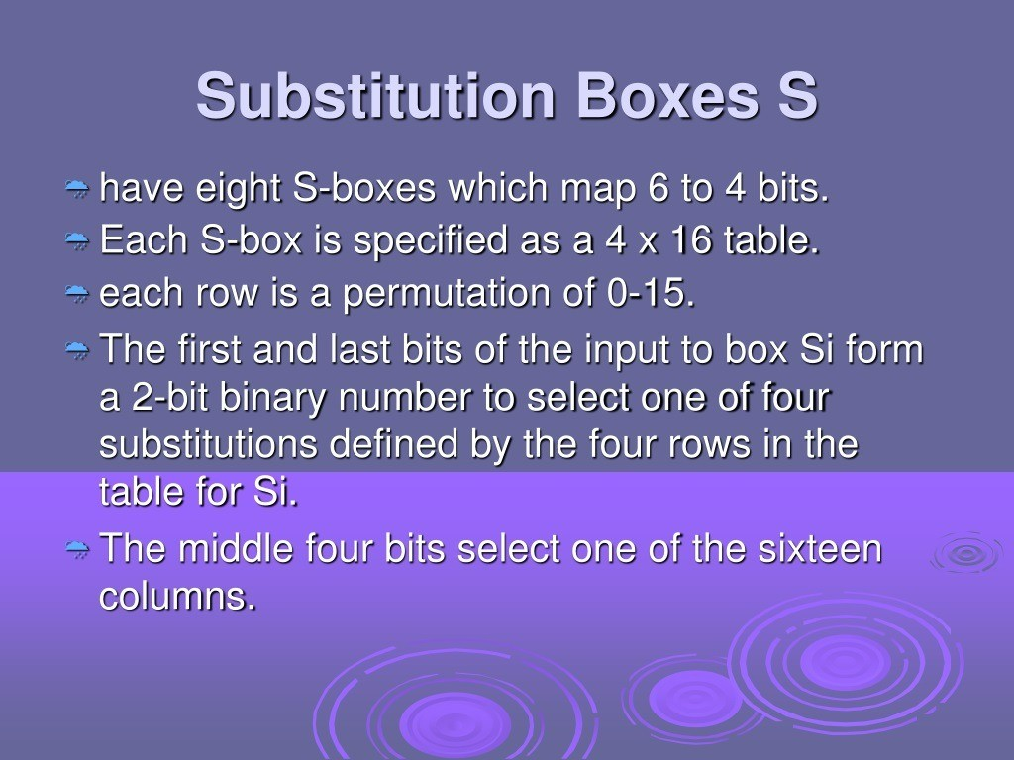

Slide 59
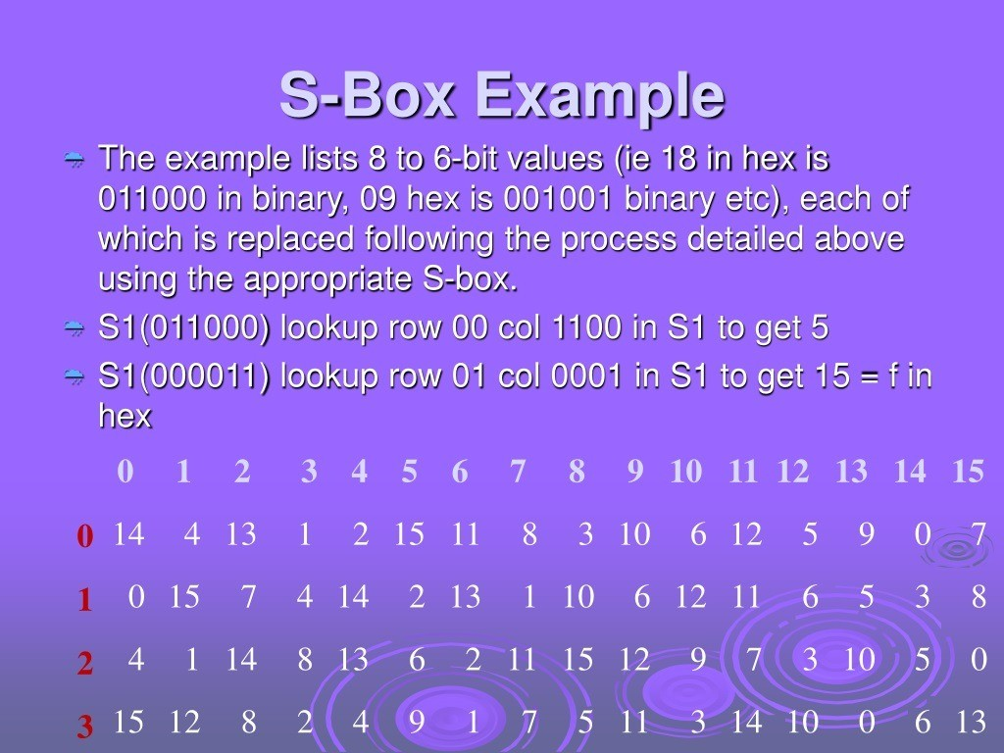

Slide 60
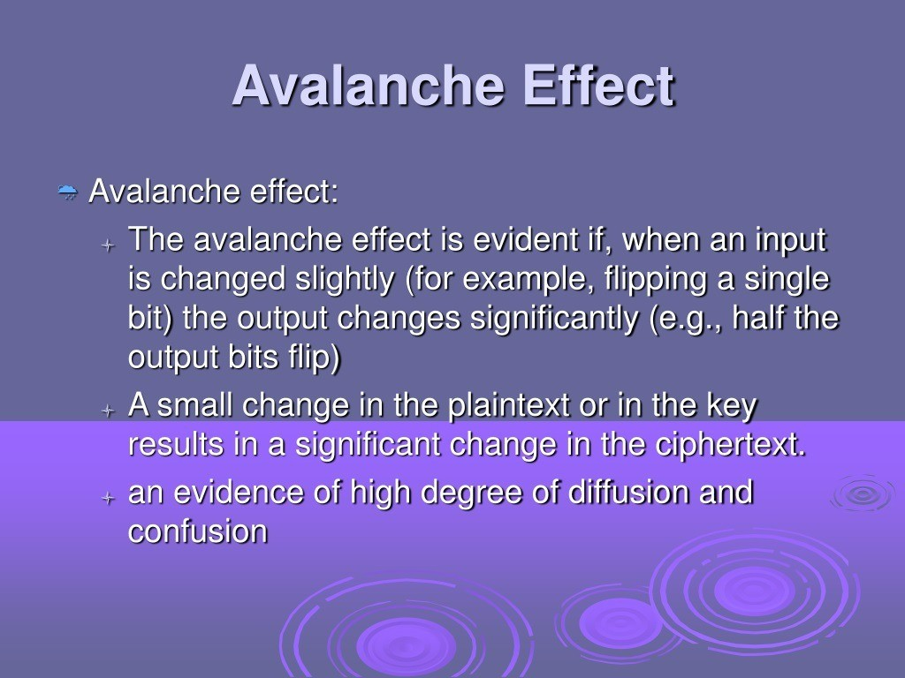

Slide 61
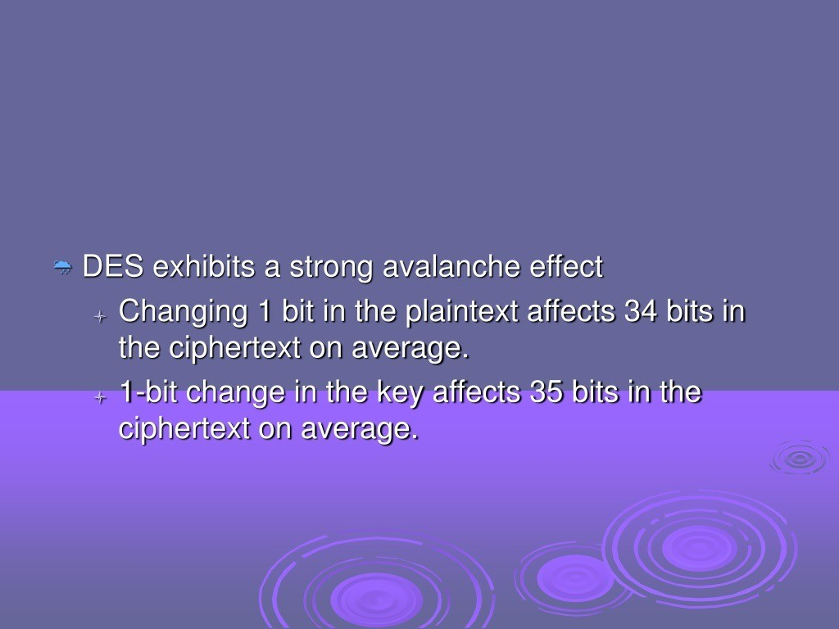

Slide 62
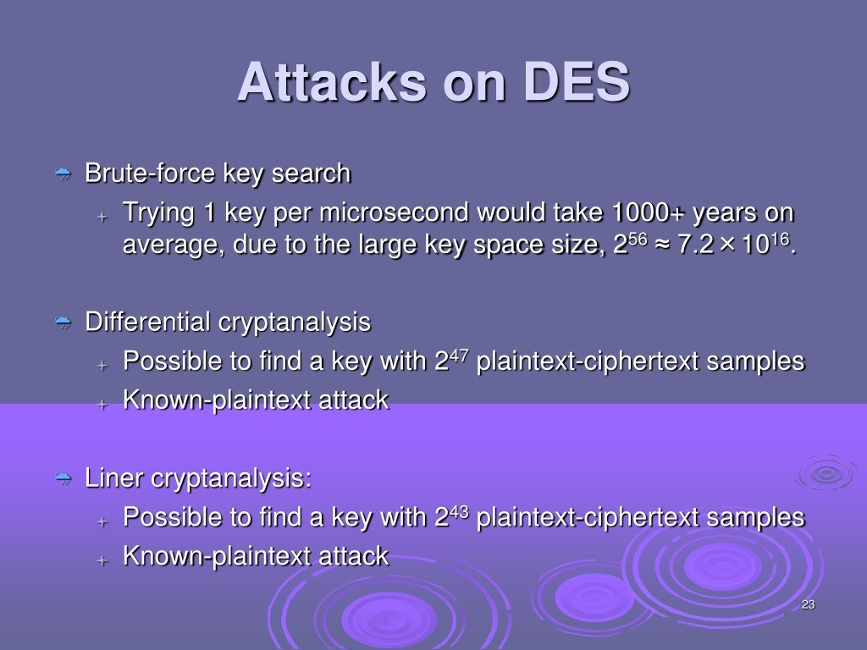

Slide 63
2DES
Problem with Single DES
DES uses a 56-bit key.
As computing power increased, a brute-force attack (trying all possible keys) became feasible.
In fact, DES was cracked in less than a day using specialized hardware.
2DES means applying the DES algorithm twice with two different keys:
Why Double it?
In theory, using two 56-bit keys should give 112 bits of key space, making brute-force much harder.
It's a natural step up from single DES, without entirely redesigning the algorithm.
Encryption: C = E_K2(E_K1(P))
Decryption: P = D_K1(D_K2(C))
Where E is DES encryption, D is DES decryption, K1 and K2 are two different keys

Slide 64
2DES
But... Meet-in-the-Middle Attack
Unfortunately, 2DES is still vulnerable to a meet-in-the-middle attack, which reduces the effective security to about 2⁵⁷, only slightly better than single DES.
Takeaway:
2DES was a step toward strengthening DES, but it's not secure enough today.
It helped inspire Triple DES (3DES), which applies DES three times and is more secure (though now even 3DES is being phased out in favor of AES).

Slide 65
Self Study
Working principle of AES
https://youtu.be/X8whYEWoDSI?si=YDq8uahFHQk6_vvQ
An example https://youtu.be/ZPLEtxxjCYA?si=cfiE_LhhX_tTwgJY

Slide 66


Slide 67


